Slide 1
National Board Certification 3.0
Awareness Session
Regional Meeting
May 7, 2014
Notes:
Revised 4/10/2014

Slide 2
Agenda
Welcome and Introductions
Updates on NBC 3.0
Panel Discussion
Discussion

Slide 3
Our Learning Outcomes
I can explain how and why NBPTS began.
I can state the Five Core Propositions.
I can describe the parts of the NBC process.
I can see how teachers are being supported.
I can discuss how teachers, students, and schools benefit from this process and how it fits into the current initiatives.

Slide 4
Mission
The Mission of NBPTS is to advance student learning and achievement by
establishing the definitive standards and systems for certifying accomplished educators,
providing programs and advocating policies that support excellence in teaching and leading, and
engaging National Board certified teachers and leaders in that process.

Slide 5
National Board Certification is:
Recognition for accomplished teaching—content knowledge and teaching pedagogy
Advanced certification
Voluntary
Assessment based on national standards of accomplished teaching developed by teachers and other educators

Slide 6
Standards Based Performance Assessment
Standards are based on the NBPTS policy statement, What Teachers Should Know and Be Able to Do, and the Five Core Propositions
Standards are written by practicing classroom teachers, developmental experts and educational leaders in each respective disciplinary field, from across the country
Standards are widely disseminated for public review, approved by the NBPTS Board of Directors and made available online at no charge

Slide 7
The Five Core Propositions
Accomplished teachers …
Are committed to students and their learning.
Know the subjects they teach and how to teach them to students.
Are responsible for managing and monitoring student learning.
Think systematically about their practice and learn from experience.
Are members of learning communities.
Notes:
The Five Core Propositions describe what highly accomplished teachers should know and be able to do. These are the basis of all of the certificate area standards. All certificate standards have these commonalities. There is high regard for the knowledge, skills, and abilities that teachers must have in order to be successful, and there is recognition that what highly accomplished teaching looks like and sounds like in the Kindergarten classroom is different than in a high school English classroom. So, while these propositions are the common themes of accomplished teaching, the certificate area standards provide the depth and breadth of teaching in a particular subject area at a particular developmental level.

Slide 8
Revisions to the NBC Process
Why Revise…
To incorporate the latest research.
To remove barriers.
Notes:
Just as we ask
teachers to be reflective in their practice,
NBPTS is reflecting on the certification process to ensure it mirrors the evolving nature of the
profession and current research on best practices in teaching. The process was last revised in 2001
We are working with National Board Certified Teachers (NBCTs)and other experts
in the profession to remove barriers in the process that have nothing to do with whether a teacher is accomplished.

Slide 9
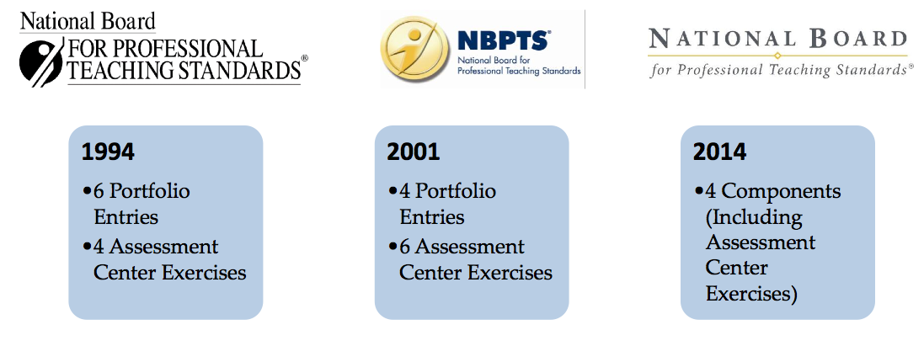
Evolution of NBC

Slide 10
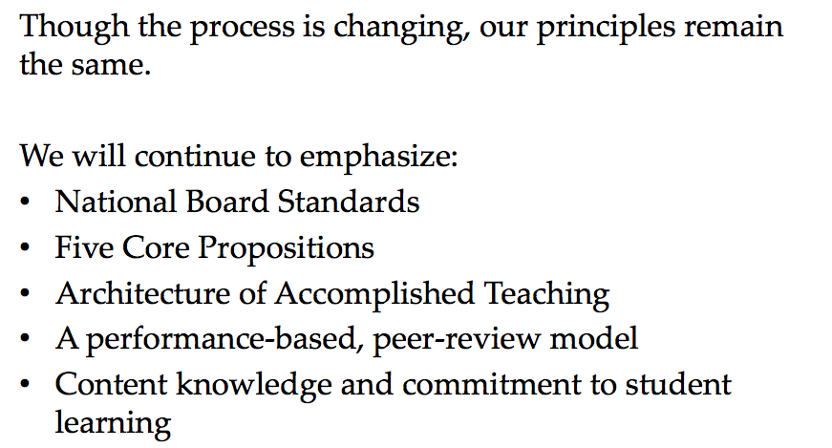
What’s not changing

Slide 11
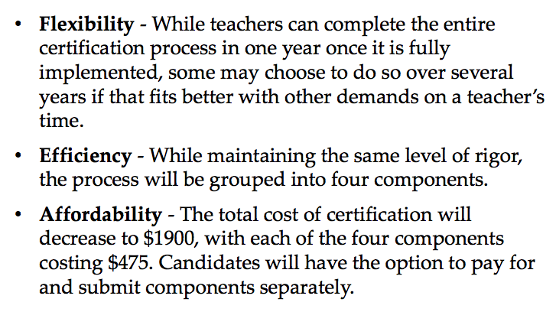
What is changing

Slide 12
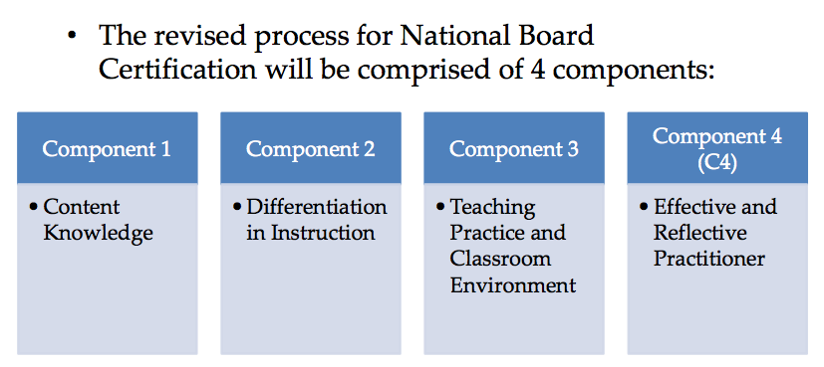
The Design

Slide 13
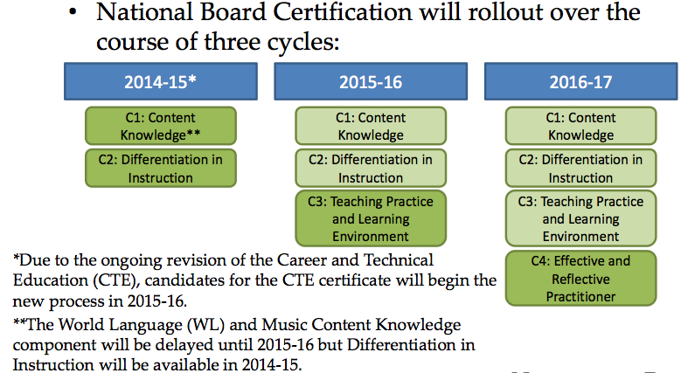
The Roll Out

Slide 14
Crosswalk
Old Model New Model
Assessment Center Exercises
Component 1: Content Knowledge
Entry 1 Student Work
Component 2
Differentiated
2014
Entry 2 or 3 video
Component 3
Teaching Practice and Classroom Environment
Entry 4
Documented Accomplishments
2016
2015
Component 4
Effective and Reflective Practitioner
2014

Slide 15
2014 (Choose 1 or 2 Components)
Component 1
  Requires subject matter knowledge and pedagogy across the developmental levels of your certificate area.
  Is delivered at a computer-based testing center.
  Has 3 (30 minute) constructed response exercises and 60 minutes for the selected response section
Component 2 Differentiation In Instruction
  Compromised of written commentary and demonstration of student growth over time.
  Requires analysis and reflection about instructional choices and student work samples.
Notes:
This is the last year this format will be available. The process will change in the 2014 and will take 3 years for the next cycle to complete.

Slide 16
Certificate Areas
National Board Certification is offered in 25 different certificate areas across 7 developmental age groups, covering more than 95% of preK-12 education.
Art
Career and Technical
Education
Counseling
English as a New Language
English Language Arts
Exceptional Needs Specialist
Generalists
Early Childhood
Middle Childhood
Health
Library Media
Literacy: Reading-Language Arts
Mathematics
Music
Science
Social Studies-History
Physical Education
School Counseling
World Languages Other than English
French
Spanish

Slide 17
Eligibility
National Board Certification Eligibility
Educators with access to a preK-12 classroom
3 years of teaching experience
Certified in area
Tenure for NYSED Albert Shanker Grant Funding

Slide 18
NBPTS Deadlines
Dates | Actions
Now –Dec 31st | Apply a boardcertifiedteachers.org
April 1-May 15th | Submit ePortfolio - Component 2
March 2-June 15 | Complete Component 1 Testing Window

Slide 19
Personalize your Timeline
You may take one or more components per year.
You must attempt each of the four components within a 3-year period.
After each initial attempt of a component, you will have 2 opportunities to retake.

Slide 20
NBPTS Fees
Cost
$75 | Registration fee (non-refundable)
$475 | Per component ($1,900 to total)
March 2-June 15 | Complete Component 1 Testing Window

Slide 21
The Process
apply
Write & Collaborate
submit
Register and Apply
Prepare
Read
Describe
Component 2 By May 15th.
Standards
Components Requirements
Analyze
Reflect
Create
Plan
Complete Component 1 by June 15th.
Learn
planning
collecting
documenting
analyzing
reflecting

Slide 22
The Scoring
Defined by a rubric based on standards and core propositions
Assigned by trained scorers in the specific teaching field
Holistic
Valid, fair and reliable
Applicable for 2 additional years.

Slide 23
Research
Most recently, a 2012 study by Harvard University’s Strategic Data Project found that students of NBCTs in the Los Angeles Unified School District made learning gains equivalent to an additional two months of instruction in math and one month in English Language Arts.
Notes:
Years of research confirm the impact of National Board Certified Teachers (NBCTs) on student learning and achievement
In 2008, a comprehensive meta-analysis of 11 studies conducted by the National Research Council concluded “the evidence is clear that National Board certification distinguishes more effective teachers from less effective teachers with respect to student achievement”.

Slide 24
Support for Participants
^{Support Groups}
  ^{Teacher Centers}
  ^{District-based}
  NYSUT Education and Learning Trust
  ^{Universities/Colleges}
^{District Support}
  ^{Time}
  Administrator Support and Awareness
  ^{Materials/ technology}
  Professional Development hours/time
  ^{District Support}

Slide 25
Support for National Board Candidates
NYS Albert Shanker Grant
    Tenure
    3 years of experience
NYSUT Writing Institutes
NYS Teacher Centers
147 Trained NBCTs to provide Candidate Support
Notes:
$600 for Advanced Candidate in high needs schools > 50% FARL

Slide 26
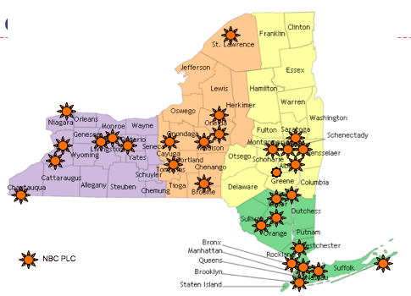

Currently:
48 NBC Cohorts in NYS
Regional Coordinator

Slide 27
Time-line
Regional Awareness
Informational Sessions
Regional Summer Institute
May 7th 4-6
Hilton Garden Inn Troy
Panel & Discussion
Various locations, and NBCT facilitators will lead cohorts.
July 9-11
Carey Conference Center
2 Facilitators

Slide 28
Time-line
Monthly Cohort Sessions
Regional Writing Institute
Component 2 Writing
Component 1 Content Knowledge
Notes:
We will need to change the time frame of the writing institute to probably early Dec.
Component 2 August to January
Component 1 January to April

Slide 29
What do National Board Certified Teachers do for schools?
Build learning communities
Support mentoring for new or struggling teachers
Create closer ties among your school and your students, families and communities
Provide public distinction for your school

Slide 30
Panelists
Mary Eads, NBCT, Vice President of Niskayuna TA
Carol Forman-Pemberton, Director GCRTC
Dr. Lynn Macan, Superintendent, Cobleskill Richmondville CSD
Ellen Sullivan, NYSUT (SEED Team)

Slide 31
NBCNY Network at CASDA
New Grants and Opportunities
Support Educator Effectiveness and Development (SEED) Grant. State-wide / 5 Districts
State Farm Grant-State-wide
  5 Regional Teacher Leader Summits for NBCTs
NYSED Grant: To fund videos and lessons on the CCSS from NBCTs

Slide 32
Support Educator Effectiveness and Development (SEED) Grant
3 Partners: NYSED/NBCNY/ NYSUT
NBCT in Residence w/ NBCNY at CASDA (TOSA)
5 High Needs Districts Across the State
SEED Team:
  NBCNY: Betsy Smith ,Annette Romano,
    Colleen McDonald, Lorraine Scorsone
  NYSUT: Ellen Sullivan
  NYSED: Dr. Stephanie Wood-Garnett
  IHE: Dr. Stephan Danna (SUNY Plattsburgh,
  Deanna Darling (Nazareth)

Slide 33
Support Educator Effectiveness and Development (SEED) Grant
Grant Coordinator: Betsy Smith
1.5 million/ 3 years
2 Aims:
  To increase the number of NBCTs
  To increase teacher leadership
NBCT in Residence w/ NBCNY at CASDA (TOSA)
5 High Needs Districts Across the State
SEED is funding the NBCNY Network

Slide 34
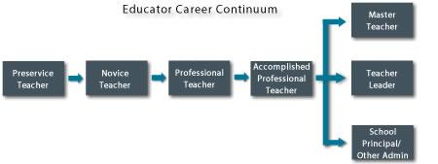
Teacher Leadership
NYSED Professional Standards and Practices Board
working to define TL as part of a novice to TL continuum as part of the Regents Reform Agenda in RttT.

Slide 35
Teacher Leadership Conference
Teacher Leader Conference
  August 21st SUNY Plattsburgh – Queensbury Campus
    Nancy Flanagan – Dr. Jill Harrison-Berg
Regional NBCT Summit – State Farm Grant
  Planning Team
  NBCTs gather in Fall

Slide 36
Discussion
Why should teachers pursue NBC and how does it fit with all the other initiatives?
APPR—Teacher Evaluation
Common Core Student Standards
Teacher Leadership
Professional Development

Slide 37
Discussion
Why should teachers pursue NBC and how does it fit with all the other initiatives?
APPR—Teacher Evaluation
Common Core Student Standards
Teacher Leadership
Professional Development
Based on reflection, Teacher
Standards, collecting evidence and articulating my practice.
Fulfills the 175 hr. PD requirement for 5 years. Will renew my passion for teaching and learning.
Requires me to analyze student work samples, goals, content knowledge, and assessments.
Allows me to grow through learning, collaborating, and leading. With take me to the next step in my career.

Slide 38
Summary
During this session you learned:
how and why NBPTS began and has changed
the Five Core Propositions.
the components of the new NBC 3.0 process.
how teachers are being supported
teachers, students, and schools benefit from NBCTs.
NBC fits into the current initiatives.
Notes:
Break into 5 groups for each group to discuss 1 aspect for 3 minutes. Present out.

Slide 39


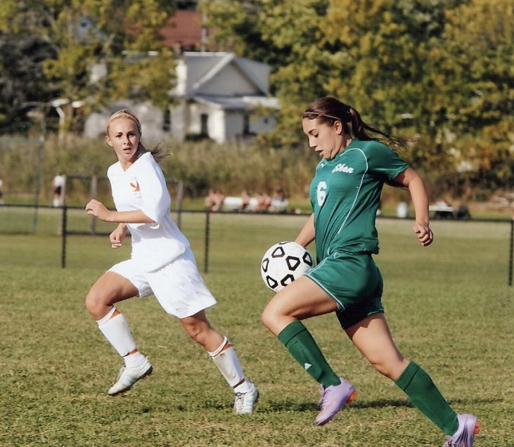




Slide 40
Resources
New Websites:
NBPTS: New Process:
www.boardcertifiedteachers.org
National Board Council of New York
www.nbcny.org
Greater Capital Region Teacher Center
www.teachers-center.org
New York State United Teachers
www.nysut.org
Presenters:
Betsy Smith- NBCNY/CASDA Ellen Sullivan-NYSUT
Dr. Lynn Macan Mary Eads, NBCT
Colleen McDonald, NBCT Annette Romano, NBCT

