Slide 1
The National Board
Certification Process
Awareness Session
NBCT Presenters: Lori Mancuso & Annette Romano, Location: Virtual
Date: April 28, 2020

Slide 2
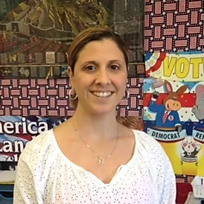
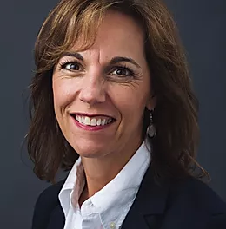
Welcome and Introductions
Lori Mancuso, NBCT
NBCNY Regional Coordinator
West Seneca NY
Annette Romano, NBCT
Clifton Park NY
Director of NBCNY
Please open the chat box and add your name, district and what you teach

Slide 3
Learning Outcomes
I can explain:
how and why NBPTS began.
the parts of the NBC process.
how teachers are being supported.
why teachers pursue NBC.
Notes:
Introductions:
Name
grade level
How have you heard about NBC?
Introduce yourself.

Slide 4
High quality professional development is...
Notes:
Chart: on a post write: Think about a professional development experience which positively impacted your instructional practice and student learning.
Share as a group
List attributes in chat box but don’t discuss

Slide 5
Mission of NBPTS
maintaining high and rigorous standards for what accomplished teachers should know and be able to do;
providing a national voluntary system certifying teachers who meet these standards; and
advocating related education reforms to integrate National Board Certification into American education and to capitalize on the expertise of National Board Certified Teachers.
Notes:
Established in 1987

Slide 6
National Board Certification is:
Recognition for accomplished teaching—content knowledge and teaching pedagogy
Advanced certification
Voluntary
Assessment based on national standards of accomplished teaching developed by teachers and other educators
Notes:
performance-based and peer-reviewed, with an emphasis on content knowledge and commitment to student learning.

Slide 7
Standards Based
Standards are based on the NBPTS policy statement, What Teachers Should Know and Be Able to Do, and the Five Core Propositions
Standards are written by practicing classroom teachers, developmental experts, and educational leaders in each respective disciplinary field, from across the country
Standards are widely disseminated for public review, approved by the NBPTS Board of Directors and made available online at no charge
Notes:
No standardize way to become NBCT
Stress how student centered the standards are.
7 NYS Standards—like boulders
The NBPTS Standards are like Bermuda Sand They articulate our professional practice in detail—fine grain—by cert/dev. level

Slide 8
The Five Core Propositions
Are committed to students and their learning.
Accomplished teachers….
Are members of learning communities.
Know the subjects they teach and how to teach them to students.
Think systematically about their practice and learn from experience.
Are responsible for managing and monitoring student learning.
Notes:
The Five Core Propositions describe what highly accomplished teachers should know and be able to do. These are the basis of all of the certificate area standards. All certificate standards have these commonalities. There is high regard for the knowledge, skills, and abilities that teachers must have in order to be successful, and there is recognition that what highly accomplished teaching looks like and sounds like in the Kindergarten classroom is different than in a high school English classroom. So, while these propositions are the common themes of accomplished teaching, the certificate area standards provide the depth and breadth of teaching in a particular subject area at a particular developmental level.

Slide 9
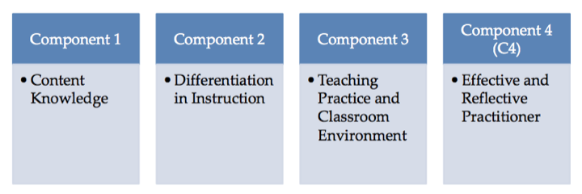
The New Design
Candidates have up to 3 years to submit 4 components.
Notes:
The new NBC process is comprised of 4 components which are all available for the first time in 2016.
You must submit all 4 components within 3 yrs. They can be submitted in any order.
You have up to two retake attempts for each component and you can retake at any time during the five-year window; retake years do not have to be concurrent or consecutive.
You can have a year when you take no components; however, it does not extend your five year window.
Move quickly to the next slide!

Slide 10
The 4 NBC Components
Component 1
Requires subject matter knowledge and pedagogy across the developmental levels of your certificate area.
Is delivered at a computer-based testing center.
3 (30 minute) constructed response exercises
60 minutes for the selected response section
Component 2
Differentiation In Instruction
Comprised of written commentary and demonstration of student growth over time.
Requires analysis and reflection about instructional choices and student work samples.
Component 3
Teaching practice and learning environment
Comprised of videos and written commentary
Requires analysis and reflection about instructional choices and video selection
Component 4
Effective and reflective practitioner
Comprised of written commentary and demonstration of:
Information from a variety of sources
Various forms of assessments
Collaboration and contributions to learning communities to advance children’s learning and growth.
Choose a combination of 1, 2, 3, 4 components.
Notes:
Don’t go too indepth

Slide 11
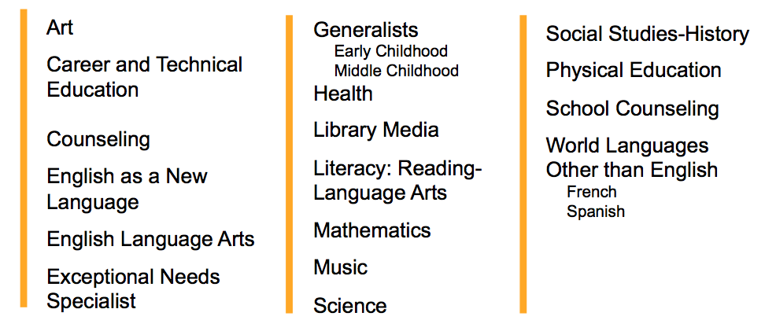
Certificate Areas
National Board Certification is offered in 25 different certificate areas across 7 developmental age groups, covering more than 95% of preK-12 education.
Notes:
Refer to NYSUT Fact sheet page 7
Notice—that there are no grade level—refer to the development level on the bottom of the page.
ask them to think about which cert they might pursue.
WLOTE candidates should read the NBC Guide for additional requirements.
○ ◾Obtain both ACTFL certifications no more than two years prior to the registration deadline of your initial year of candidacy (the year in which you complete your first component). The two separate certifications do not need to have the same certification issue date.
○ ◾Submit proof of having completed both ACTFL certifications no later than June 30 of the cycle year in which you complete initial testing on all four National Board components (no later than your third year of candidacy).
○ ◾Receive a rating of Advanced Low or higher on each ACTFL certification.

Slide 12
Eligibility
NBPTS | NYSED Albert Shanker Grant Funding
Certified in area | Tenure
Educators with access to a preK-12 classroom | Teach full time in a public school
3 years of teaching experience
Notes:
Shanker Grant is lobbied for by NYSUT each year! It needs funding in the legislature and Governor’s budget, so we cannot count on it. If you receive the grant it will cover your cost for the 3 years. Awarded on a first come first serve basis.
You must be a full time teacher in a public school for the Shanker Grant
See Applying for NBC in NY handout.

Slide 13
Additional Support for Candidates and Districts
NYSED Albert Shanker Grant program provides $2,500 per candidate:
$1900 towards NBPTS Application Fees
$500 reimbursement for the district per candidate for supportive services once they have submitted all 4 components.
NEW
For Example:
A district establishes a NB cohort of 10 candidates who apply and are awarded the Shanker grant.
$19,000 (covers all 4 components) (1,900 x 10 candidates)
+ $5,000 to the district for supportive services ($500 x 10 candidates)
$24,000 in Shanker Grant funds for professional development
100% NYS is underwriting 100 % of the cost!
Notes:
NYS Albert Shanker Grant opens on July 1st.
Tenure
Teach in a public school
3 years of experience
NYSED will disperse funds on a first come first serve basis.
Supportive services may be substitute pay, materials, facilitator, technology, etc. $500 is for the entire candidacy period, not annually.
District must complete an attestation form which describes the ways in which they are supporting candidacy and submit the form to NYSED between May and June. These funds are release to district the spring after the candidate has submitted all 4 components. Achieving isn’t a factor.

Slide 14
NBPTS Fees
Cost
$75 | Yearly Registration fee (non-refundable)
$475 | Per component ($1,900 to total)
Notes:
See Getting Ready Document for application steps.
If you have been awarded the Shanker Grant:
After the initial payment for the first component NYSED will submit all further payments.
IMPORTANT Each year you must decide which components you will purchase from NBPTS and pay the $75 fee.
Candidates do not need to reapply to the Shanker Grant.
If the candidate is awarded the Shanker Grant when they complete the process they will receive a refund of $475

Slide 15
NBPTS Deadlines
Dates | Actions
Now –Feb. 28th | Purchase components at boardcertifiedteachers.org (Please note the NYS Albert Shanker Grant deadline is aligned w/ NBPTS)
April 1-May 15 | Submit ePortfolio - Component 2, 3 and/or 4
April -June 15 | Complete Component 1 Testing Window
Notes:
Refer to the timeline resource

Slide 16
Personalize your timeline
You may take one or more components per year.
You must attempt each of the four components within a 3-year period.
After each initial attempt of a component, you will have 2 opportunities to retake.

Slide 17
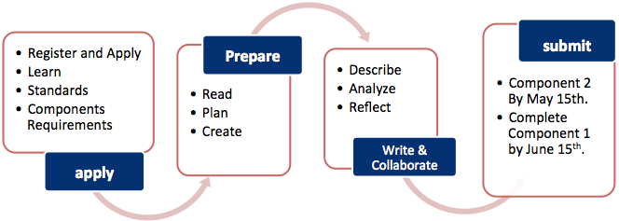
The Process
Component 2 and/or 3 by May 15th.
Component 1 by June 15th.
Read
Plan
Create
Video
Notes:
See Candidate Timeline --Resources on Nbcny.org

Slide 18
The Research
Most recently, a 2012 study by Harvard University’s Strategic Data Project found that students of NBCTs in the Los Angeles Unified School District made learning gains equivalent to an additional two months of instruction in math and one month in English Language Arts.
Notes:
NBC is the most research PD ever! See handout

Slide 19
Support for Participants
^{Support Groups/Cohort} | ^{District Support May Include}
^{NYS Teacher Centers} ^{District-based} NYSUT Education and Learning Trust (ELT)/Graduate Courses ^{Universities/Colleges} | ^{Release Time} Administrator Support and Awareness ^{Materials/ technology/copying} Professional Development hours/time ^{Trained Facilitator} ^{Financial Support for:} achieving and/or graduate credit ^{workshops/cohort fees}
Notes:
All our courses are listed on nbcny.org and GCRTC

Slide 20
NBCNY and NYSTC
Established in 2007
NBCT Regional Coordinators in each Region
NYSED CTLE Sponsor
NYS Non profit
NBCNY.org
Notes:
in 2007 the NYS National Board Council of NY was established as a network affiliate on NBPTS. It was intentionally Aligned w/ Teacher Centers to work collaboratively with you to provide support.

Slide 21
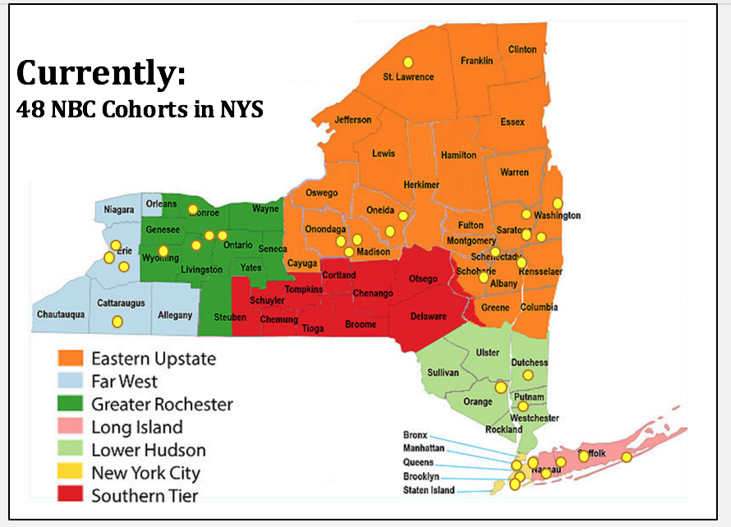
Over 300 trained facilitators ready to support candidates.
Currently supporting
over 600
candidates in over 50 cohorts.
Notes:
Over the last decade NBCNY Network has worked to establish almost 50 NBC cohorts across the state. We have trained over 300 Facilitators and we are currently supporting over 600 candidates in the new NBC process.
Our goal is to provide ethical, consistent and high quality support within 1 hr of each teacher.

Slide 22
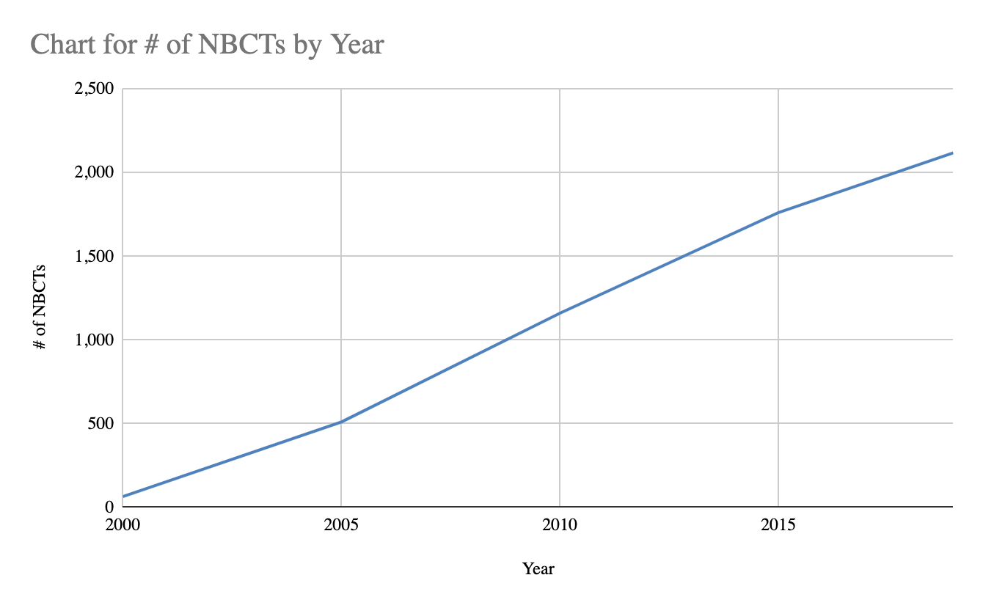
2,118 NBCTs in NY Less than 1% of teachers
Notes:
We represent only 1% of NYS teachers—Gold standard
MOC NBCT need to complete a Maintenance of Certification Every 5 years.
This change will take effect for current candidates who certify in 2017 and later. Beginning in 2021, as existing 10-year certificates expire, NBCTs will extend their certificate at five-year intervals through the new MOC process.
Development of the maintenance of certification has not yet started, but we are hoping to keep it similar to completion of a single component of the certification process every five years.
NBPT is working to keep it as close to the cost of a single component (currently $475) as possible

Slide 23
What do National Board Certified Teachers do for schools?
Build learning communities
Support mentoring for new or struggling teachers
Create closer ties among your school and your students, families and communities
Provide public distinction for your school
Model continuous learning through Maintenance of Certification (5yrs)
Notes:
.
Salary step or stipend: almost 300 locals have negotiated a salary step/stipend for NBCT’s i.e. Hasting-on-Hudson (doctoral level pay)
Stillwater (2 salary steps)
Elmsford $5,000 annual
Croton Harmon $2,500 annual
Scarsdale $3,500 one time
PNW BOCES $2,000 annual
Some contracts stipulate mutually agreed upon additional duties
Contract language provisions for district support such as facilitator, technology (video and videotaping support, recordings, copier, laptops, computers) additional flexible professional development leave days, building meeting space, materials
Determination of _# of in-service credits per component to meet CTLE or other

Slide 24
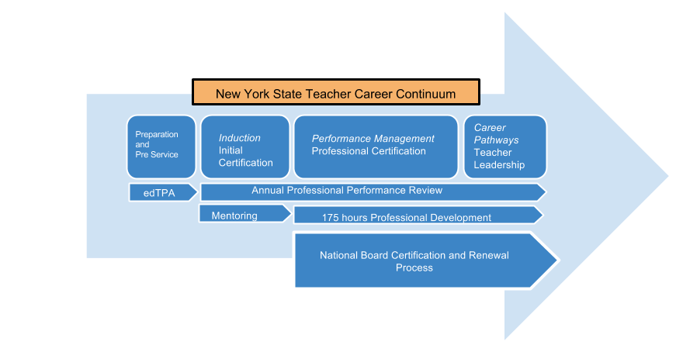
Teacher Leadership
NYS Professional Standards and Practices Board is working to define
Teacher Leadership as part of a career continuum.

Slide 25
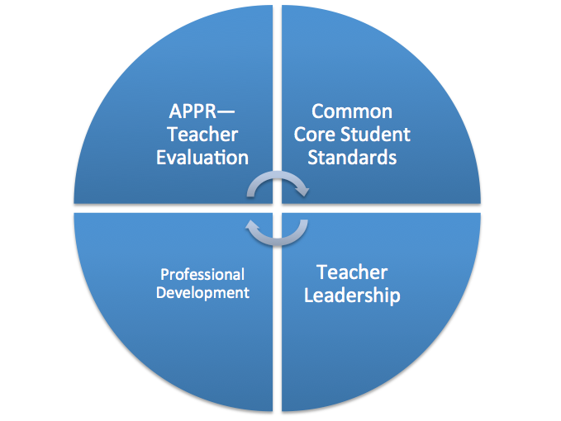
Discussion:
How does National Board fit with all of our other initiatives?
Notes:
NYS learning standards are evidenced in each component

Slide 26
Discussion:
How does National Board fit with all of our other initiatives?
Based on reflection, Teacher Standards, collecting evidence and articulating my practice.
Fulfills the 100 CTLE (PD) hr requirement for 5 years. Will renew my passion for teaching and learning.
Requires me to analyze student work samples, goals, content knowledge and assessments.
Allows me to grow through learning, collaborating, and leading. Will take me to the next step in my career.

Slide 27
How does National Board Certification align with your thoughts about high quality professional development?
Let’s check our chat box!
Notes:
Reference Chart completed earlier: Think about a professional development experience which positively impacted your instructional practice and student learning.
http://boardcertifiedteachers.org/get-started/value-for-schools video 1.30min.

Slide 28
You are READY!

Slide 29
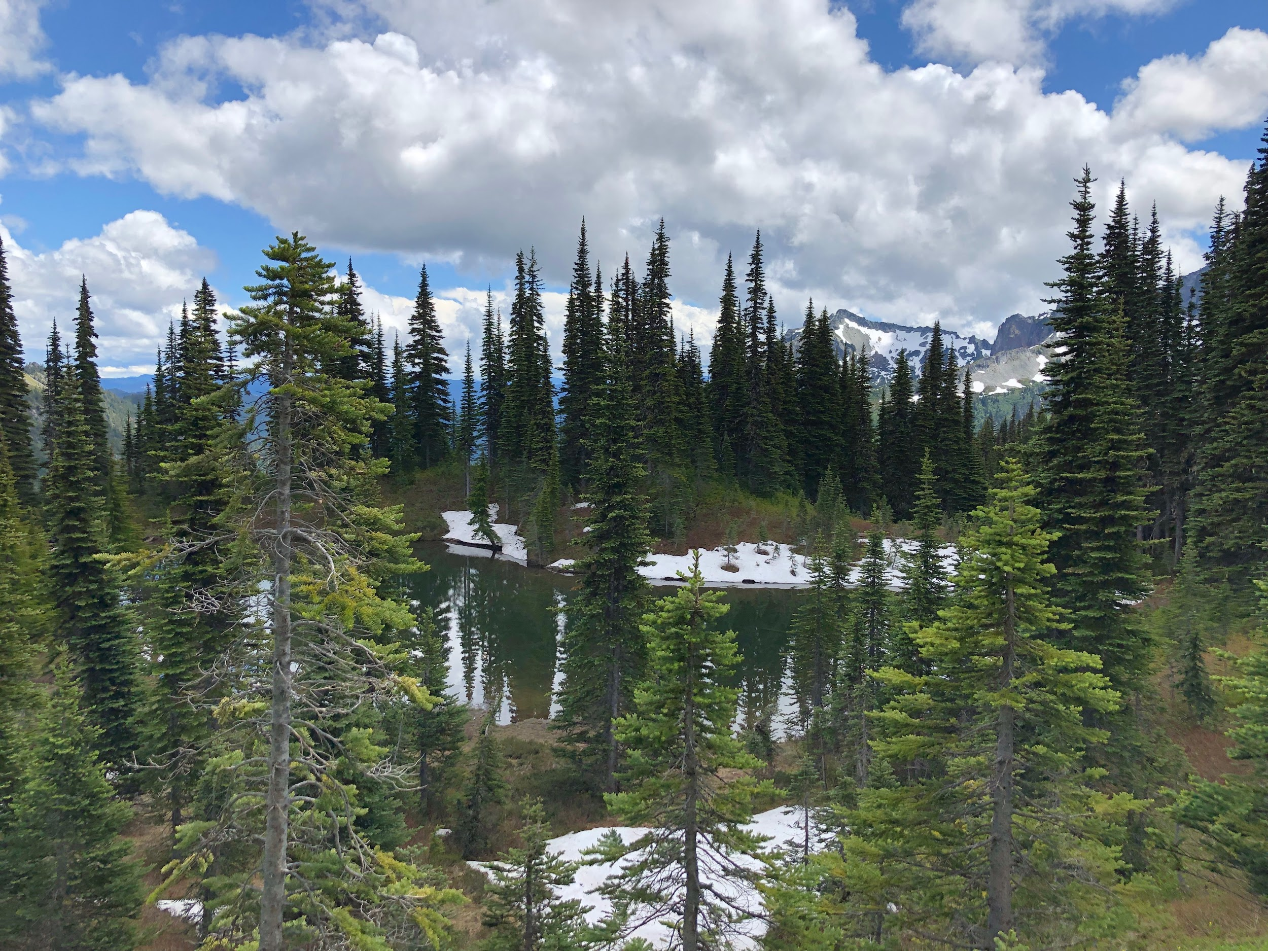
Summary
We discussed:
how and why NBPTS began.
the parts of the NBC process.
how teachers are being supported.
why teachers pursue NBC.
Notes:
Ask if they have any questions

Slide 31
Resources:
NBPTS: New Process:
www.nbpts.org
NYSED Shanker Grant
http://www.highered.nysed.gov/kiap/ashanker/albertshanker.html
National Board Council of New York
www.nbcny.org
Annette Romano, NBCT
aromano12@gmail.com
New York State United Teachers
www.nysut.org
Notes:
If you are Ready see Getting Ready Resource and Time-line

Slide 32
For our students

